Slide 1
DATA ANALYST PORTFOLIO PROJECT
UPI TRANSACTION
ANALYTICS DASHBOARD
Turning transaction data into performance insights, trend analysis, and risk-focused questions.
Primary tool: Microsoft Excel | Domain: Digital Payments
PORTFOLIO PRESENTATION • 2026

Slide 2
Executive Summary
PROJECT OVERVIEW
A single view of transaction performance, distribution, timing, and potential risk.
502,887
₹44.25 Cr
91%
17,089
Total transactions shown
Total transaction amount
Reported success rate
Suspected-fraud transactions
Project purpose
Important validation note
Use an interactive Excel dashboard to compare transaction amounts and outcomes across time, UPI apps, banks, states, and transaction types.
Figures on the dashboard are presented as displayed. Reconcile KPI definitions, filters, totals, and fraud-rate calculations with the source workbook before formal reporting.
UPI TRANSACTION ANALYTICS • EXCEL DATA ANALYST PORTFOLIO
02

Slide 3
Business Problem & Objectives
CONTEXT
Business problem
Project objectives
Transaction records contain many dimensions. Without a consolidated view, it is difficult to monitor outcomes, compare segments, and spot unusual patterns.
Summarize performance with KPIs; explore time, geography, app, bank, and type; review status distribution; and identify suspected-fraud segments for investigation.
Core analytical questions
• How much transaction value is processed, and what share succeeds?
• Which apps, banks, states, and transaction types contribute the most value?
• When is activity concentrated, and where do failed or flagged transactions need review?
UPI TRANSACTION ANALYTICS • EXCEL DATA ANALYST PORTFOLIO
03

Slide 4
Dataset Overview
DATA UNDERSTANDING
The raw-data screenshot shows transaction-level records and fields suitable for multi-dimensional analysis.
Identifiers
Time
Transaction_ID, Customer_ID
Transaction_Date, Transaction_Time
Customer
Merchant
Age_Group, Gender, State, City
Merchant_Name, Merchant_Category
Payment
Amounts
Transaction_Type, Payment_Method, UPI_App, Bank_Name
Amount_INR, Cashback, Transaction_Fee
Outcome & risk
Dataset size and date range should be calculated directly from the workbook; the screenshot alone is not enough to validate them.
Status, Failure_Reason, Device_Type, Risk_Score, Is_Suspected_Fraud
UPI TRANSACTION ANALYTICS • EXCEL DATA ANALYST PORTFOLIO
04

Slide 5
Data Preparation & Quality Checks
METHODOLOGY
Inspect schema
Confirm columns, data types, date/time formats, and units.
01
Validate records
Check missing values, duplicate IDs, and inconsistent categories.
02
Prepare features
Derive hour, weekday, month, and other time fields when needed.
03
Validate calculations
Reconcile amounts, cashback, status counts, and fraud-rate denominator.
04
Report only the cleaning steps actually completed; treat the list above as a validation framework until confirmed.
UPI TRANSACTION ANALYTICS • EXCEL DATA ANALYST PORTFOLIO
05

Slide 6
KPI Framework & Definitions
METRICS
Total transactions
Total amount
Count of valid transaction records or unique Transaction_IDs.
Sum of Amount_INR within the selected filters.
Average transaction value
Success rate
Total transaction amount ÷ transaction count.
Successful transactions ÷ total transactions × 100.
Failure rate
Cashback
Failed transactions ÷ total transactions × 100.
Sum of Cashback; cashback rate needs an explicitly defined denominator.
Suspected-fraud count
Fraud rate
Count of records with Is_Suspected_Fraud = Yes.
Flagged transactions ÷ defined transaction population × 100.
UPI TRANSACTION ANALYTICS • EXCEL DATA ANALYST PORTFOLIO
06

Slide 7
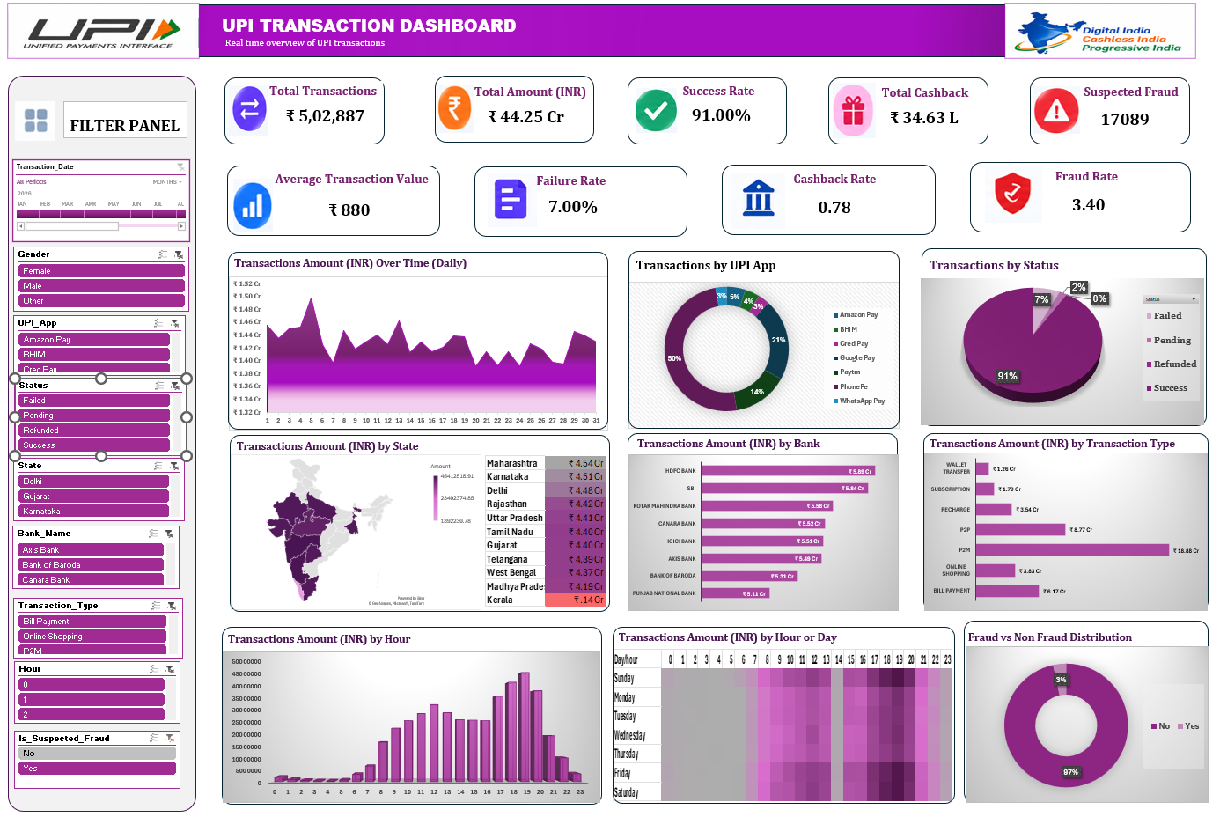
Interactive Excel Dashboard
DASHBOARD
KPI cards
Transaction count, total amount, success, cashback, and suspected fraud.
Filters
Date, gender, app, status, state, bank, transaction type, hour, and fraud flag.
Dashboard value
Compare multiple dimensions from one interactive view and identify areas for deeper analysis.
UPI TRANSACTION ANALYTICS • EXCEL DATA ANALYST PORTFOLIO
07

Slide 8
How to Read the Charts
ANALYTICAL APPROACH
Trend charts
Composition charts
Comparison charts
Show how transaction amount changes over dates or hours.
Show the share of activity by app, status, or fraud flag.
Rank states, banks, and transaction types by amount.
Good analytical practice
• Use the chart to identify a pattern, then verify exact values in the source data.
• Separate transaction count from transaction value.
• Avoid claiming causes or confirmed fraud from a visual pattern alone.
UPI TRANSACTION ANALYTICS • EXCEL DATA ANALYST PORTFOLIO
08

Slide 9
Dashboard Walkthrough
DASHBOARD
The dashboard combines summary KPIs, interactive filters, and nine analytical chart views.
Performance
Segmentation
Timing & risk
Total transactions, amount, average amount, success, failure, and cashback.
UPI app, status, state, bank, and transaction type.
Daily trend, hourly pattern, day-hour heatmap, and suspected-fraud split.
Use slicers to narrow the analysis, then compare the affected KPI cards and charts. When presenting results, state the active filter context so the audience understands what the figures represent.
UPI TRANSACTION ANALYTICS • EXCEL DATA ANALYST PORTFOLIO
09

Slide 10
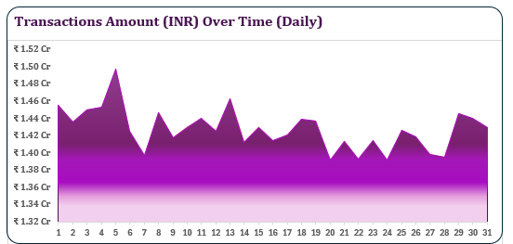
Daily Transaction Amount Over Time
CHART ANALYSIS
Business question
How does transaction value vary from day to day?
What the chart shows
The daily amount fluctuates across the month, with a visible peak early in the period and lower values on several later dates. Use the workbook to verify the exact peak and trough dates.
Business interpretation
Daily monitoring can highlight unusual changes, but the chart alone does not explain why they occurred.
Recommended follow-up
Compare daily transaction count, average transaction value, and status mix on peak and low days.
Presenter script
This chart shows daily transaction amount. I would investigate the highest and lowest days and compare them with transaction volume and payment outcomes before explaining the changes.
UPI TRANSACTION ANALYTICS • EXCEL DATA ANALYST PORTFOLIO
10

Slide 11
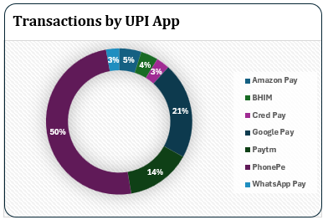
Transactions by UPI Application
CHART ANALYSIS
Business question
Which UPI applications account for the largest share of transactions?
What the chart shows
PhonePe is the largest displayed segment at about 50%, followed by Amazon Pay at about 21% and BHIM at about 14%. Smaller app shares are shown in the chart.
Business interpretation
The distribution indicates where activity is concentrated. A larger share does not automatically mean better service quality.
Recommended follow-up
Compare app-wise transaction count, success rate, failure rate, average amount, and suspected-fraud rate.
Presenter script
The app chart shows that transaction activity is concentrated in a few applications. To assess performance, I would also compare each app's success and failure rates.
UPI TRANSACTION ANALYTICS • EXCEL DATA ANALYST PORTFOLIO
11

Slide 12
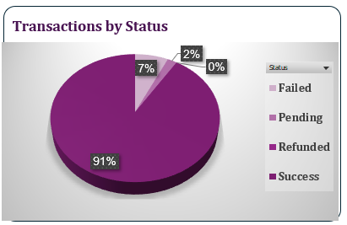
Transactions by Status
CHART ANALYSIS
Business question
What proportion of transactions succeed or require follow-up?
What the chart shows
The displayed status chart reports approximately 91% Success, 7% Failed, 2% Pending, and 0% Refunded after rounding.
Business interpretation
The non-success portion represents an opportunity to examine failed and unresolved transactions. Rounded labels may not add up precisely.
Recommended follow-up
Break down failures by bank, app, hour, and failure reason; review pending transactions separately.
Presenter script
The chart indicates a 91% success rate, while failed and pending transactions need further analysis. I would use the failure-reason field to look for actionable patterns.
UPI TRANSACTION ANALYTICS • EXCEL DATA ANALYST PORTFOLIO
12

Slide 13
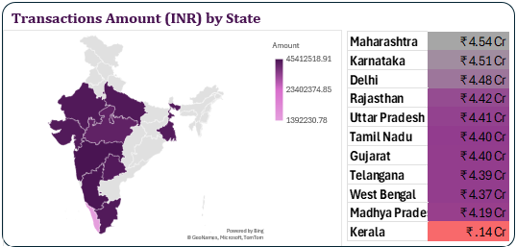
Transaction Amount by State
CHART ANALYSIS
Business question
Which states contribute the most transaction value?
What the chart shows
The dashboard ranks Maharashtra at about ₹4.54 Cr, Karnataka ₹4.51 Cr, Delhi ₹4.48 Cr, Rajasthan ₹4.42 Cr, and Uttar Pradesh ₹4.41 Cr among the displayed leading states.
Business interpretation
The map and ranking show geographic distribution of transaction value, not necessarily customer count or transaction frequency.
Recommended follow-up
Compare state-wise transaction count, average transaction value, success rate, and suspected-fraud rate.
Presenter script
This view compares transaction amount across states. Maharashtra and Karnataka appear near the top in the displayed ranking, and I would compare these totals with transaction counts.
UPI TRANSACTION ANALYTICS • EXCEL DATA ANALYST PORTFOLIO
13

Slide 14
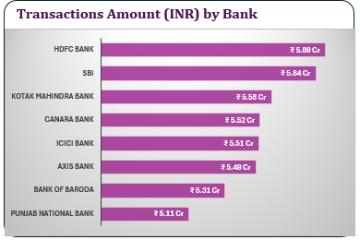
Transaction Amount by Bank
CHART ANALYSIS
Business question
How is transaction value distributed across banks?
What the chart shows
HDFC Bank and SBI lead the displayed ranking at approximately ₹5.89 Cr and ₹5.84 Cr. Other banks shown include Kotak Mahindra Bank, Canara Bank, ICICI Bank, Axis Bank, Bank of Baroda, and Punjab National Bank.
Business interpretation
High transaction value reflects activity or ticket size; it does not by itself measure reliability or customer experience.
Recommended follow-up
Compare each bank's transaction volume, success rate, failure reasons, and suspected-fraud rate.
Presenter script
This chart ranks banks by transaction value. I would combine it with status metrics so that the analysis evaluates both volume and payment reliability.
UPI TRANSACTION ANALYTICS • EXCEL DATA ANALYST PORTFOLIO
14

Slide 15
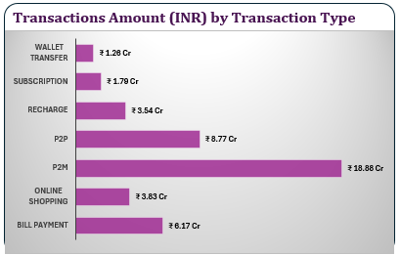
Transaction Amount by Transaction Type
CHART ANALYSIS
Business question
Which payment use cases contribute the most transaction value?
What the chart shows
P2M is the largest displayed category at approximately ₹18.88 Cr, followed by P2P at ₹8.77 Cr and Bill Payment at ₹6.17 Cr. Other displayed categories include online shopping, recharge, subscription, and wallet transfer.
Business interpretation
Different use cases can have different transaction sizes and frequencies, so amount and count should be evaluated separately.
Recommended follow-up
Compare transaction count, average transaction value, and status/fraud rates by transaction type.
Presenter script
P2M contributes the largest displayed transaction amount. I would next check whether this is driven by more transactions, larger average amounts, or both.
UPI TRANSACTION ANALYTICS • EXCEL DATA ANALYST PORTFOLIO
15

Slide 16
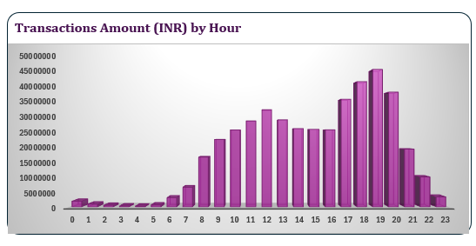
Transaction Amount by Hour
CHART ANALYSIS
Business question
At what times of day is transaction value highest?
What the chart shows
The displayed hourly pattern rises through the morning and afternoon and peaks in the evening, with the highest bars around 18:00–19:00. Confirm the exact peak hour from the source workbook.
Business interpretation
Time-of-day patterns can support monitoring and staffing decisions, but should be validated across multiple dates.
Recommended follow-up
Compare hourly transaction count, failure rate, and suspected-fraud rate; assess weekday versus weekend patterns.
Presenter script
The hourly chart suggests stronger transaction value in the evening. I would validate the peak hour and check whether failures or flagged transactions also rise during that period.
UPI TRANSACTION ANALYTICS • EXCEL DATA ANALYST PORTFOLIO
16

Slide 17
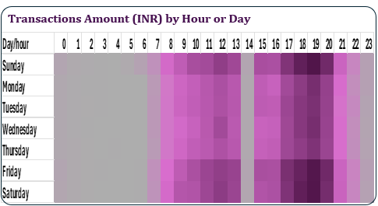
Transaction Amount by Day and Hour
CHART ANALYSIS
Business question
How does transaction activity vary by weekday and hour?
What the chart shows
The heatmap shows relatively low activity in early hours and stronger activity in later daytime and evening periods. Darker cells indicate higher values according to the displayed color scale.
Business interpretation
A heatmap helps spot recurring time windows that can be missed in a single hourly average.
Recommended follow-up
Validate the aggregation used in each cell and compare weekdays with weekends using transaction count as well as amount.
Presenter script
This heatmap combines day of week and hour. It helps identify time windows with relatively higher activity, which I would validate with exact aggregated values.
UPI TRANSACTION ANALYTICS • EXCEL DATA ANALYST PORTFOLIO
17

Slide 18
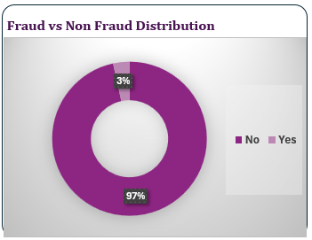
Suspected Fraud vs. Non-Fraud Distribution
CHART ANALYSIS
Business question
How many transactions are flagged for potential fraud?
What the chart shows
The displayed distribution is approximately 97% not flagged and 3% flagged. The dashboard KPI shows 17,089 suspected-fraud transactions; the exact rate should be reconciled against the full dataset.
Business interpretation
A suspected-fraud flag is a risk indicator, not proof that fraud occurred. Rate calculations depend on the denominator and filter context.
Recommended follow-up
Validate the fraud flag and denominator, then segment flagged transactions by amount, hour, bank, app, state, and transaction type.
Presenter script
The chart shows a small flagged share compared with the non-flagged group. I would prioritize investigation and measure confirmed outcomes rather than treating every flag as confirmed fraud.
UPI TRANSACTION ANALYTICS • EXCEL DATA ANALYST PORTFOLIO
18

Slide 19
Key Findings from the Dashboard
INSIGHTS
Payment outcomes
App distribution
The dashboard reports 91% success and 7% failure, with small pending/refunded shares shown after rounding.
PhonePe is the largest displayed app segment at about 50%; app share should be assessed alongside reliability metrics.
Transaction use case
Time pattern
P2M is the largest displayed transaction-type amount at about ₹18.88 Cr; compare count and average value to understand the driver.
Hourly and heatmap views suggest stronger activity later in the day; verify exact peaks from the workbook.
Risk interpretation
The dashboard shows 17,089 suspected-fraud records and approximately 3% flagged in the distribution chart. Reconcile the KPI and denominator before reporting a precise rate.
UPI TRANSACTION ANALYTICS • EXCEL DATA ANALYST PORTFOLIO
19

Slide 20
Business Recommendations
ACTION PLAN
1. Monitor failures
Track failed transactions by app, bank, hour, and Failure_Reason.
2. Review risk flags
Prioritize suspected-fraud records for review and track confirmed outcomes.
3. Compare value and volume
Report both transaction count and amount for states, banks, apps, and transaction types.
4. Monitor time windows
Validate recurring peak hours and compare weekdays with weekends.
5. Standardize KPI logic
Document numerator, denominator, units, date range, and filter context for every rate.
UPI TRANSACTION ANALYTICS • EXCEL DATA ANALYST PORTFOLIO
20

Slide 21
Data Quality, Assumptions & Limitations
VALIDATION
• The presentation uses the supplied dashboard and chart screenshots; exact aggregations should be reconciled to the original workbook.
• The visible screenshots do not establish the complete row count, date range, or all cleaning outcomes.
• Rates can change with slicer selections; note filter context when reporting metrics.
• A suspected-fraud flag indicates potential risk, not confirmed fraud.
• A high transaction amount does not necessarily imply high transaction count or better performance.
• Use source data to validate exact dates, hourly peaks, totals, and any ranking before presenting.
UPI TRANSACTION ANALYTICS • EXCEL DATA ANALYST PORTFOLIO
21

Slide 22
Technical Workflow & Skills Demonstrated
METHODOLOGY
Source data
Preparation
Analysis
Visualization
Decision support
→
→
→
→
Transaction-level records
Validate, clean, and derive fields
Aggregate by time, app, status, state, bank, type
KPI cards, PivotCharts, slicers, heatmap
Findings, follow-up questions, recommendations
Tools to describe only if actually used
• Excel formulas, PivotTables, PivotCharts, slicers, conditional formatting, and dashboard layout.
• Future extensions: SQL for reusable queries, Power BI for sharing, Python for deeper analysis, and ML for risk-model experiments.
UPI TRANSACTION ANALYTICS • EXCEL DATA ANALYST PORTFOLIO
22

Slide 23
Future Scope: SQL, Power BI, Python & ML
ROADMAP
SQL
Power BI
Build reusable queries, validate KPI totals, and create bank/app/time-based aggregations.
Rebuild interactive reporting with a semantic model, DAX measures, and drill-through.
Python
Machine learning
Automate data checks, explore distributions, and create repeatable analysis notebooks.
If confirmed labels and suitable features are available, evaluate fraud-risk models with proper validation and class-imbalance handling.
These are proposed extensions, not claims that the current Excel project already includes these tools.
UPI TRANSACTION ANALYTICS • EXCEL DATA ANALYST PORTFOLIO
23

Slide 24
Project Summary & Learning Outcomes
CONCLUSION
This project demonstrates how Excel can turn transaction-level data into an interactive business view.
• Summarized payment performance through KPI cards.
• Compared transaction value across applications, banks, states, and transaction types.
• Explored daily, hourly, and day-hour activity patterns.
• Highlighted suspected-fraud records for further investigation.
• Translated visual patterns into clear follow-up questions and business recommendations.
Portfolio message
I used Excel to organize transaction data, visualize patterns, and identify areas for deeper business analysis.
UPI TRANSACTION ANALYTICS • EXCEL DATA ANALYST PORTFOLIO
24

Slide 25
THANK YOU
Questions & Discussion
UPI TRANSACTION ANALYTICS DASHBOARD
Data Analyst Portfolio Project
Microsoft Excel • Digital Payments • Data Analysis

